Slide 1
PRINCIPLES OF ECONOMICS
Salimah Musharrif
FPEC 101 – LECTURE 8 Unit 2

Slide 2
PRINCIPLES OF ECONOMICS
Production Costs and Market Structures
FPEC 101 – LECTURE 8 Unit 2

Slide 3
Market Structures- Perfect Competition

Slide 4
Outline
Market Structures
Perfect Competition

Slide 5
Market Structures
A market structure describes how the market is organized in terms of how much competition there is, usually on the supply side.
The amount of competition in a market may be examined by the following:
The amount of control the firm or a group of firms has over the market supply or output
The influence a firm or a group of firms has over the market price
The freedom new suppliers have to enter a market
Barriers to entry that restrict competition

Slide 6
Market Structures
Pure competition involves a very large number of firms producing a standardized product (that is, a product identical to that of other producers, such as corn or cucumbers). New firms can enter or exit the industry very easily.
Pure monopoly is a market structure in which one firm is the sole seller of a product or service (for example, a local electric utility). Since the entry of additional firms is blocked, one firm constitutes the entire industry. Because the monopolist produces a unique product, it makes no effort to differentiate its product.

Slide 7
Market Structures
Monopolistic competition is characterized by a relatively large number of sellers producing differentiated products (clothing, furniture, books). There is widespread nonprice competition, a selling strategy in which one firm tries to distinguish its product or service from all competing products on the basis of attributes like design and workmanship (an approach called product differentiation). Either entry to or exit from monopolistically competitive industries is quite easy.
Oligopoly involves only a few sellers of a standardized or differentiated product; so each firm is affected by the decisions of its rivals and must take those decisions into account in determining its own price and output.

Slide 8
Perfect Competition
Perfect competition is defined as “a market structure in which the decisions of buyers and sellers have no effect on the market price”. There are a large number of buyers and sellers producing standardized products.
Under the structure firms are encouraged to make the best possible use of resources and in order to make profit, to give consumers the best value for money.

Slide 9
Perfect Competition - Features
All firms produce the same standardized product, so no buyer has any preference for any product)
The firm is a price taker (No buyer or seller can influence the price. They have to accept the price given by the industry and so are price takers)
There’s free mobility of all resources (there’s no restriction on the movement of factors of production and production can be easy increased)
There’s free entry and exit of all firms (no barriers to firms joining in to produce a product the other firms are receiving a profit in, or to leave if they face a loss)
There is perfect knowledge about prices [All buyers know everything about the prices and products on sale while all sellers know everything about the latest production techniques and other competitors)
There are no barriers to the movement of buyers from one seller to another
An example of perfect competition, though not perfect, is wheat production. There is perfect knowledge among producers but none of them can affect the price.

Slide 10
Perfect Competition
The demand schedule faced by the individual firm in a purely competitive industry is perfectly elastic at the market.
Market demand graphs as a downward sloping curve. An entire industry (all firms producing a particular product) can affect price by changing industry output. For example, all firms, acting independently but simultaneously, can increase price by reducing output.
But the individual competitive firm cannot do that

Slide 11
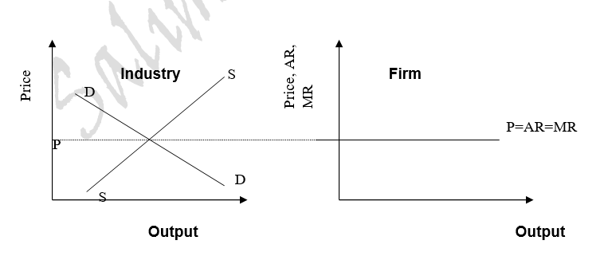
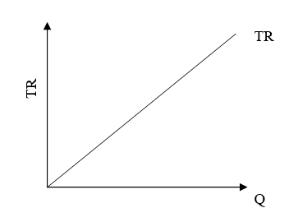
Perfect Competition
Price | Quantity Demanded | Total Revenue | Average Revenue | Marginal Revenue
5 | 1 | 5 | 5 | -
5 | 2 | 10 | 5 | 5
5 | 3 | 15 | 5 | 5
5 | 4 | 20 | 5 | 5
5 | 5 | 25 | 5 | 5

Slide 12
Profit Maximization in the Short Run
A purely competitive firm can maximize its profit (minimize its loss) only by adjusting output
Two Approaches:
total revenue-total cost approach
marginal revenue-marginal cost approach

Slide 13
Break-even point
TR, TC Approach
Profit = TR – TC
BE = TR=TC
TR = PxQ
TC = Cost x Q
Maximum profit where vertical distance between TR and TC curves is greatest
TR
Maximum economic profit
TR
TC
Break-even point (normal profit)

Slide 14
  Short Run Profit Maximization- MC, MR Approach
A firm shall continue production rather than shutting down as long as MR>MC
Profit maximization or loss minimization is where MC = MR or Price = MC since P=AR=MR
If marginal revenue does not equal or exceed average variable cost, the firm will shut down rather than produce the MR =MC output
The firm will produce so that it gets greatest amount of total profit, not its per-unit profit.
In the short run, firms may earn supernormal profit or an abnormal profit, which means average revenue is>average total cost.
In short, profit is maximized, or loss minimized, at the output at which marginal revenue (or price in pure competition) equals marginal cost, provided that price exceeds average variable cost.

Slide 15
Perfect Competition – Loss Minimization
These occur when the firm’s costs are not met. The firm continues to run in the short run if its variable costs are being met because perhaps in the long run the fixed costs will be covered. So average avenue is greater than Average variable cost, but average revenue is less than average total cost
Why do firms under perfect competition continue to produce under a no profit, no loss situation?
When profits are equalized in the short run a firm under perfect competition will continue to produce because it may not be making a monetary profit or the accountants profit but profit in terms of opportunity cost is much greater, example at if it shuts down it will have to cover both fixed and variable costs but by continuing production it covers its variable cost and at least some part of the fixed cost

Slide 16
Short Run Profit
Output where MR =MC
Profit as ATC is less than P=AR=MR
Cost and Revenue
MC
P=AR=MR
Economic Profit
MC = MR
ATC
Q Output

Slide 17
Short Run Loss
Output where MR =MC
Loss as ATC is more than P=AR=MR
AVC is less than AR so no shutdown
Cost and Revenue
MC
ATC
Loss
P=AR=MR
AVC
MC = MR
Q Output

Slide 18
Short Run Shutdown
Shutdown as AVC is more than AR
Cost and Revenue
MC
ATC
AVC
P=AR=MR
Q Output

Slide 19
Marginal Cost and Short-Run Supply
ATC
P
MC
Costs and revenues (dollars)
AVC
P3
MR3
Q3
Q

Slide 20
Marginal Cost and Short-Run Supply
P
ATC
MC
Costs and revenues (dollars)
AVC
P₃
MR₃
P₂
MR₂
At a lower price
a lower quantity
will be supplied
Q₂
Q₃
Q

Slide 21
Marginal Cost and Short-Run Supply
ATC
P
MC
Costs and revenues (dollars)
P₄
AVC
MR₄
P₃
MR₃
P₂
MR₂
At a higher price
a higher quantity
will be supplied
Q₂
Q₃
Q₄
Q

Slide 22
Marginal Cost and Short-Run Supply
ATC
P
MC
P₅
MR₅
Costs and revenues (dollars)
P₄
AVC
MR₄
P₃
MR₃
P₂
MR₂
P₁
MR₁
Firm should not
produce
below P₂
Q₂
Q₃
Q₄
Q₅
Q

Slide 23
Marginal Cost and Short-Run Supply
P
ATC
Short-run
supply curve
(Above AVC)
MC
P₅
MR₅
Costs and revenues (dollars)
P₄
AVC
MR₄
P₃
MR₃
P₂
MR₂
P₁
MR₁
Q₂
Q₃
Q₄
Q₅
Q
Notes:
Quantity supplied would be zero at any price below the minimum average variable cost (AVC).

Slide 24
Profit Maximization – Long Run
Assumptions
Free Entry and exit of firms.
Identical costs All firms in industry are similarly affected by any long-run adjustments that occur.
Constant-cost industry Entry and exit of firms does not affect resource prices or, consequently, the locations of the average-total-cost curves of individual firms.
In the long run firm only earns normal profit. This means it is a no profit or no loss situation or the firm’s average total costs are met. That is, average revenue is >Average total cost.
Supernormal profit does not exist in the long run because there are no barriers to the entry and exit of firms. Firms earning a supernormal profit attract other firms in the industry so that the total supply in the market increases and profit decreases.
Under subnormal or abnormal losses as losses accrue some of the firm’s leave the industry which decreases supply and increases prices so that costs are covered.

Slide 25
Entry Eliminates Economic Profits
Demand increases
S₁
P
MC
P
ATC
$60
$50
$40
$60
$50
$40
Economic Profits
MR
D₂
D₁
Q
Q
100
100,000
Firm
(price taker)
Industry
1000 firms

Slide 26
Entry Eliminates Economic Profits
new firms enter, S increases, P falls
S1
MC
P
ATC
P
S₂
$60
$50
$40
$60
$50
$40
MR
D₂
New Equilibrium with more firms
D1
Q
Q
100
100,000
Firm
(price taker)
110,000
Industry
110,000 firms

Slide 27
Exit Eliminates Losses
If product demand decreases...
S₁
MC
P
P
ATC
$60
$50
$40
$60
$50
$40
Economic Loss
MR
D₁
D₂
Q
Q
100
100,000
Firm
(price taker)
Industry
1000 firms

Slide 28
Exit Eliminates Losses
firms exit, S decreases, P increases
S₃
S₁
MC
P
P
ATC
$60
$50
$40
$60
$50
$40
MR
New equilibrium with fewer firms
D₁
D₂
Q
Q
100
90,000
100,000
Firm
(price taker)
Industry
90,000 firms

Slide 29
Long Run- Constant, increasing and decreasing cost
The long-run supply curve for a constant-cost industry is horizontal because the entry or exit of firms does not affect resource prices or, therefore, unit costs. An increase in demand causes an increase in industry’s output without a change in price and vice versa.
In an increasing-cost industry the entry of new firms in response to an increase in demand will bid up resource prices and thereby increase unit costs. Thus there is an increased industry output but at higher prices.
In decreasing cost industry, the firm’s AC curves shift downward, and the market price of the product falls. The lower price and the lower AC of production induce a new long-run equilibrium with more firms, a lower price and more output. Thus, in a decreasing-cost industry, the long-run supply curve is downward-sloping. Also because expansion itself lowers input prices or firms can use scale economies to produce at lower cost.

Slide 30
SUMMARY
Market Structures
Perfect Competition
  Definition
  Features
  Short Run Profit Maximization
    TR TC approach
    MR, MC Approach
  Long Run Approach
    Profit
    Loss
    Shutdown

